Slide 1

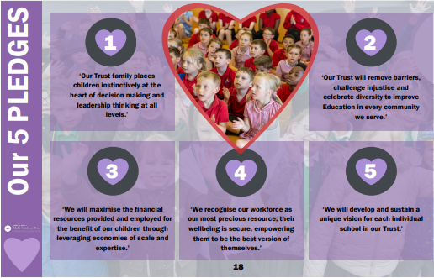
Bath and Wells Multi Academy Trust
All Saints Church School
School Development Plan Priorities 2025 - 2026
Jesus says, “All things are possible if you believe.” Mark 9:23
All Saints Church School Values
PERSERVERANCE| RESPECT |FRIENDSHIP| LOVE| COMMUNITY | WISDOM
OUR STRATEGIC GOALS
Goal 1: Refine the curriculum to ensure clear structure, progression, and knowledge across all subjects, providing consistent high-quality learning that promotes depth of thought and challenge.
Goal 2:
Embed courageous advocacy through sustainability actions that develop the climate action plan, empowering pupils as ethical, active global citizens and agents of change
Goal 3:
To improve and enrich pupil participation by ensuring teacher explanations are clear, precise and effectively modelled using a range of pedagogical techniques.
Goal 4:
To embed pupil book study as a regular and systematic practice to inform and support subject leadership, curriculum development, teaching quality and pupil success and achievements
We believe that by helping each other, we can grow to be the very best. Our community cares and nurtures all children in a safe learning environment by being open minded to curiosity and creativity. We always show respect, love and perseverance to everyone within our school. LIKE THE GOOD SHEPHERD, if we remember all our school values and our individual gifts from God, we can build upon our wisdom for the greater community. Within a culture of compassion and friendship, we can become the best versions of ourselves!
When we work together, we can make everything possible.
BWMAT 5 PLEDGES
OUR SCHOOL VISION
Our Education Strategy is built on ‘Eight Characteristics of Excellence’. Through co-production with schools, we have identified what we believe will make the biggest difference to children achieving the best. Reflective Leadership; Starting well together on their education journey; A curriculum for an ever-changing world; Teaching excellence along with inspired learning; The celebration of diversity and difference; An environment where physical and mental wellbeing encourages learning to flourish; Outward facing opportunities - looking beyond the horizon;
We know and believe if these key characteristics are at the forefront of everything we do, we will achieve excellence.

