Slide 1

Foundation Stage Literacy
Drawing Club

Slide 2

Education done with children not to them – Greg Bottrill
Notes:
Previous approaches in Acorns involved lots of worksheets and initial sound matching and letter formation. It didn't inspire children and develop their writing further than the intended LO. This has unlimited potential.

Slide 3

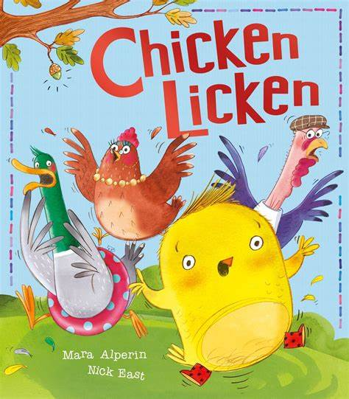

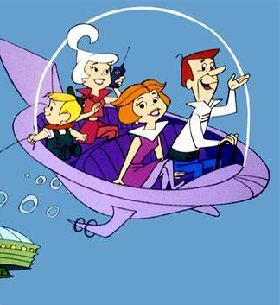
It sounds like fun - that’s because it is!
Drawing club is meant to sound like fun, it is meant to inspire and excite children to mark make and write.
It meets the ability of your child, extending their learning at a point that builds their confidence.
Notes:
Starts with a story or a cartoon!! It is a fun hook and from here we look at characters, plots and alternative endings.

Slide 4
What a typical Drawing club session looks like
Whole class teaching with vocabulary and modelling.
Children are invited to join Drawing club 3 days a week in small groups, there is a clear objective to each drawing.
Children will have a number square and sound mat available to them at all times whilst drawing.
Any writing and numbers are refered to as 'code'. The idea is that the code can affect their drawing and create magic. This helps to build children's imagination and storytelling as well as making their marks purposeful.
Notes:
The children have to complete their code but most want to without request! Marking is given via feedback and modelling – do not draw on their work, it is theirs!

