Slide 1

Information for
Acorn Class
and KS1 Parents/Carers
Notes:
Thank you so much for coming this evening. Harness that excitement of becoming readers – because they will be challenges and we want to create readers that enjoy reading!

Slide 2

Aims of this session;
to be introduced to our Phonics scheme
to understand how we teach Phonics
to explore Phonic resources
to learn about how you can support early reading at home
to understand the importance of developing our children’s fine motor skills
Notes:
GS
Everyone comes to phonics with their own past history of learning to read, I remember letter land and bill, chip and kipper!
Its so important that you are familiar with how your children are being taught so that you can support that learning at home.
Fine motor – ready to write?

Slide 3
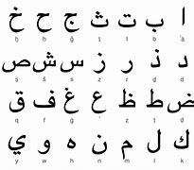
Can you read this?
Notes:
GS
So with that in mind - Can you read this for me?! This is what your children are doing everyday – this is why they are so tired!

Slide 4
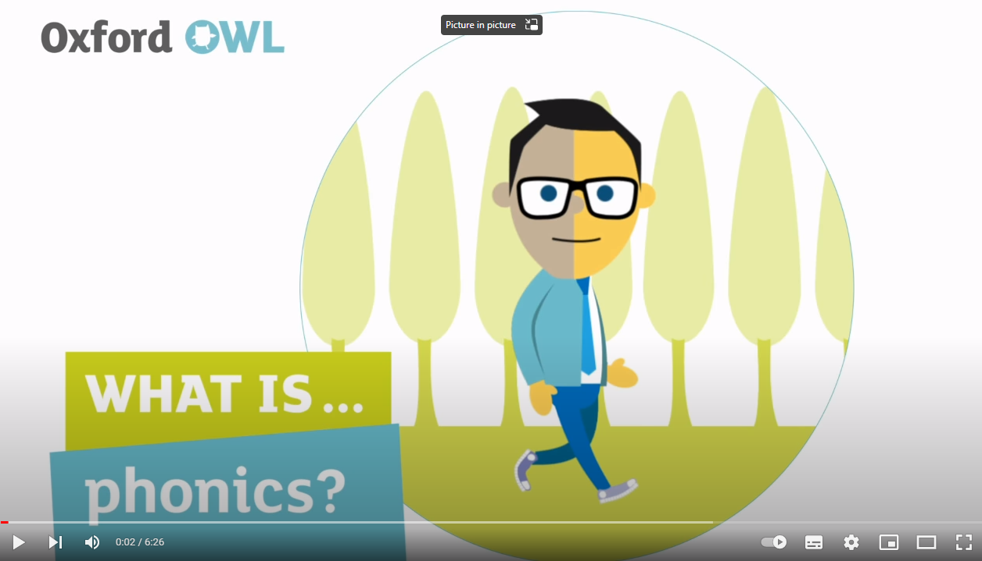
What is Phonics?
What is phonics? | Oxford Owl - YouTube
Notes:
GS
STOP VIDEO AT 4MIN
To clarify QUIZ! letter sound is a phoneme, the physical letter is a grapheme. Two letters is a diagraph, three letters is a trigraph. Split diagraphs

Slide 5
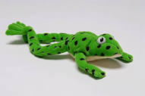

Read Write Inc. is a popular phonics scheme. Like all phonics schemes, it teaches children the sounds in English, the letters that represent them, and how to form the letters when writing.
Why did we choose this scheme?
Who is ‘Fred’?
https://home.oxfordowl.co.uk/reading/reading-schemes-oxford-levels/read-write-inc-phonics-guide/
Through this link you can access lots of free resources to support your child’s learning.
This powerpoint will be available on our website.
Notes:
As seen in the video this is Systematic Synthetic Phonics (SSP) one of many schemes – its about consistently in resources, books, sound mats when explicitly teaching phonics. This helps reduce the cognitive load for pupils. Routine and structure.
GS – This is fred! Fred talk – sounding it out!
Videos on tapestry demonstrating the pure sounds

Slide 6
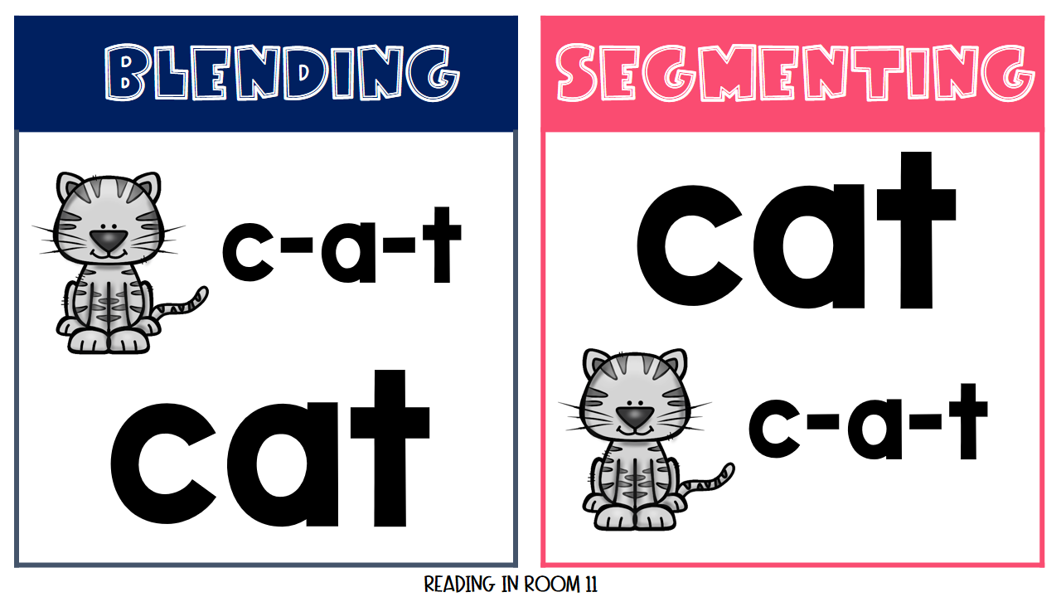
Developing phonemic awareness
Before and while teaching phonics, it is important we make sure children can listen for sounds – they need to develop the ability to hear sounds before they can read. They will be learning this at school through a process we call oral segmenting and blending.
What can you do to help?
I spy…
Say the word in sounds, eg. c-a-t.
Ask your child to repeat. Can they ‘jump-in’ with the whole word?
Say the word in sounds followed by the whole word eg. c-a-t, cat
Ask your child to repeat
Oral segmenting and blending talk throughout the day…
Shall we have some l-u-n-ch?
What would you like to p-l-ay?
Let’s put on your c-oa-t!
Notes:
So thinking of fred and his fred talk, one of the keys ways you can support your child is breaking the sounds down in words. When talking to your children are you going to have j-a-m on your toast?

Slide 7
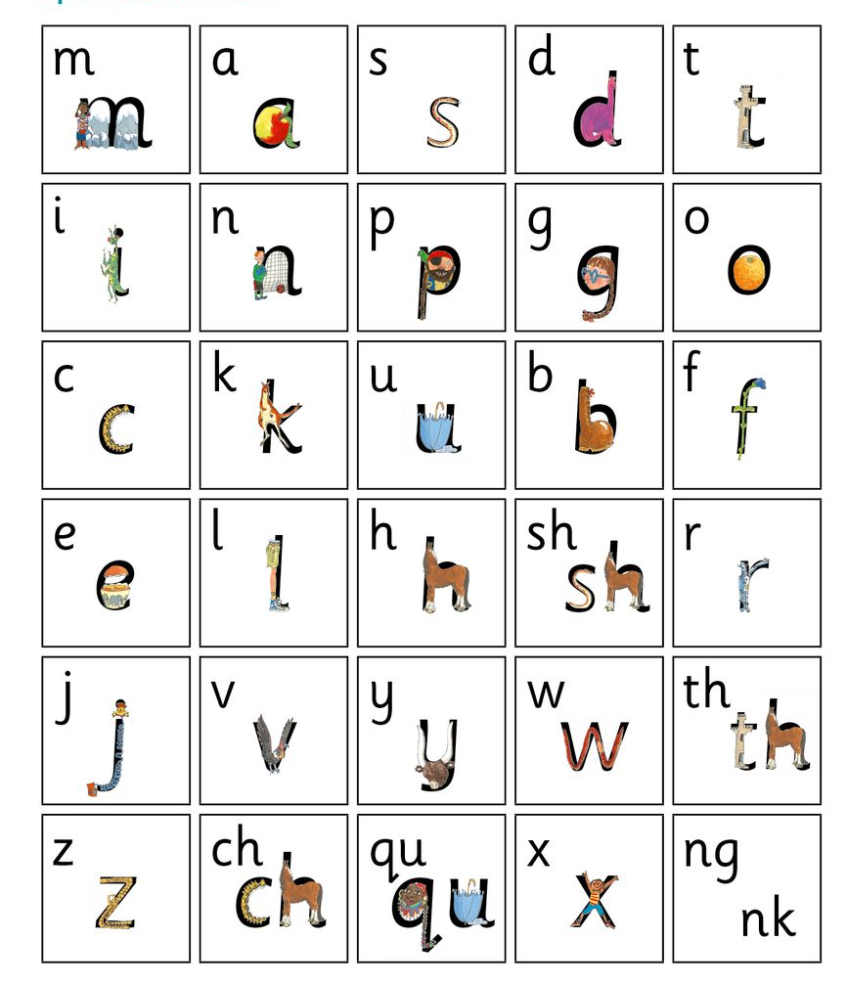
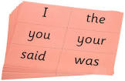
Children will start by learning Set 1 sounds
Alongside these they also learn red words (sight or tricky words), which are difficult to blend but are words they need to read and access texts (e.g. the, said, your).
Red words will eventually come home in the form of bookmarks with the red words they will encounter in the level they are working at.
Tricky words
High frequency words
Common exception words
What can you do to help?
Practice sounds at home - when homework comes home, help your child to practice correct letter formation as they say the sound/phoneme when writing.
Use letter sounds – not names of letters.
Practise reading red words at home.
Notes:
GS, mention ‘pure sounds’.
Talk about the daily phonics sessions, teach, speedsounds, baking trays, letter formation, green word cards, my turn your turn.
Special friends? Fred talk, say the word. Red words – tricky words and bookmarks.

Slide 8
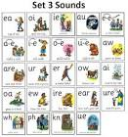
Phonics in Class 1
75 – the number of taught sound in R.W.I scheme
Pure sounds – single sounds (a, b, c, d)
Di/trigraph - two (di-) or three (tri-) letters which together create one sound.
Schwa – a vocal sound added after the phoneme
Phoneme – sound created by letters in a word
Grapheme – the written form of the spoken sound
In Set 1, children start learning the single letter graphemes. Once secure with these, and with blending, they move to learning Set 1 digraphs.
Set 1 : sh, ch, th, ng, nk, qu, ck, s,s ff, ll, zz.
Set 2: ay, ee, igh, ow, oo/oo,
Set : teaches the alternative graphemes and trigraphs such as a_e & ai.
Assessed fortnightly
Children will bring home sounds to practice or a link to the Virtual classroom to watch with your child.
Notes:
BW – This slide and the next slide, can you comment on how phonics changes in year 1 and how we manage that transition?
Can you also mention alien words and how this ties in with the phonic screener?
Fred in your head, speedy words

Slide 9
Phonics in Class 1
What do Year 1 learn in phonics?
From Year 1, children begin to learn Set 3, with regular consolidation of Sets 1 & 2, which are first taught in Reception.
What is the ‘phonics screening check?
Near the end of Year 1, children in all UK mainstream schools sit a governmentally issued ‘screening test’. This is administered by myself, as Phonics Lead, 1-1, in a quiet, comfortable space.
Children practice incrementally with past paper materials so they can accurately demonstrate their knowledge.
What does the Phonics Screener look like for my child?
It involves reading a list containing 40 real and pseudo- words. We call these ‘alien’ or ‘nonsense’ words. They will get a score out of 40.
This assessment informs their learning as they move into Year 2 (then beyond).
Words in the screening check will include the taught 44+ phonemes and graphemes.
Notes:
How phonics changes in year 1
Phonics Screener

Slide 10
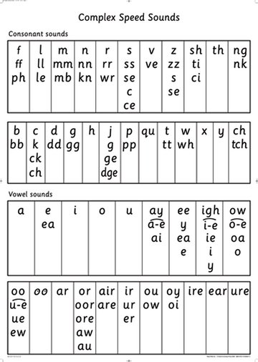
How does Phonics support spelling?
During Year 1, children learn alternative spellings for the 44+ phonemes (sounds) in the English language. They will begin to memorise correct spellings, applying this to their writing.
Notes:
BW- spelling

Slide 11
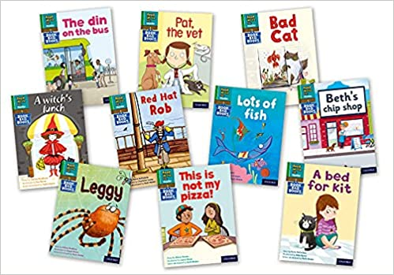
When will my child bring home
reading books?
Your child will only bring home book bag books after we have ensured they can:
quickly and accurately recognise the sounds/phonemes of the alphabet (not the name of the letters) that have been taught
blend simple sounds to hear the words ‘they make’ e.g. ‘p-i-g’ makes pig and ‘b-u-s makes bus.’
This focus on synthesising words, by blending their individual sound components, is why the teaching approach is called synthetic phonics. To avoid your child coming to think reading relies on just guessing words from the pictures, or trying to memorise words by their shape, we ensure they master the basic letter/ sound combinations before sending home readers.
Books without words - lilac
Notes:
GS – alongside a book, you will have an activity or book on oxford owl.
Look at the back for questions to ask your child

Slide 12
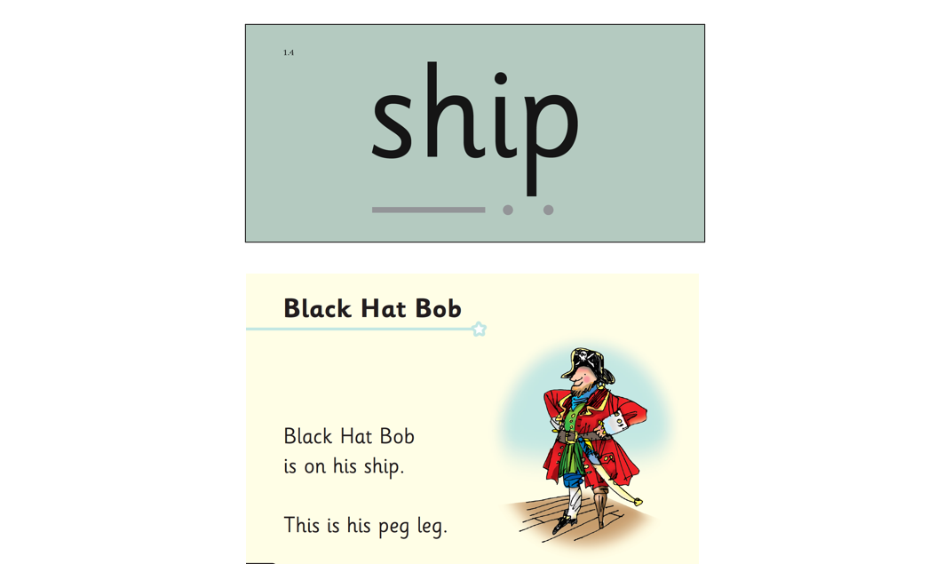
Listening to your child read
Children should be able to read all of the words in their new book bag book.
If they hesitate, remind them to read the word by reminding them to ‘sound it out using sound buttons (segment) and then blend the sounds / phonemes together to read the word’.
For example, this means they spot the ‘sh’, then sound out and blend to read the word e.g. sh, sh-i-p, ship.
Oxford Owl elibrary
Notes:
GS

Slide 13
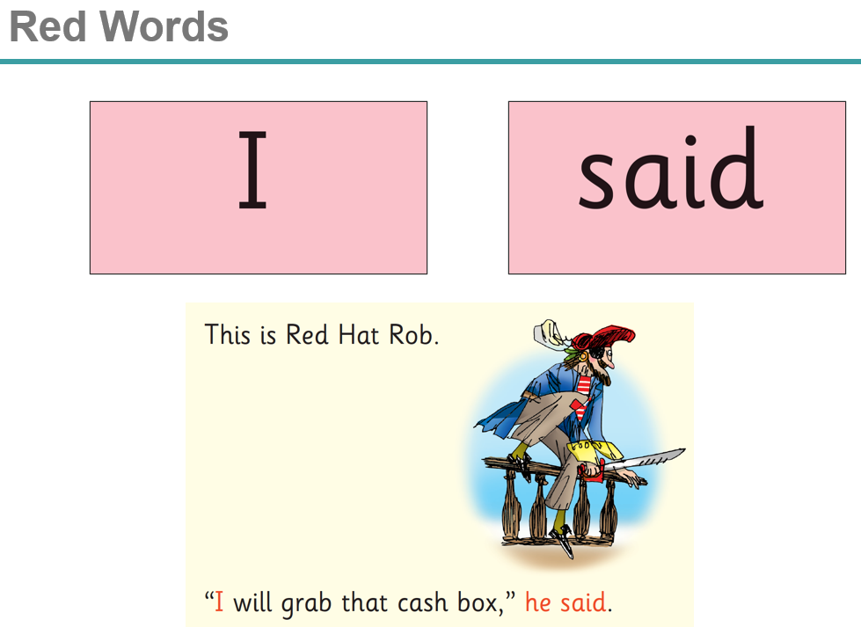
Listening to your child read
Some words are ‘tricky’ because they contain letters that don’t match the sounds the child has been taught.
For example, ‘said’ has ‘ai’ making an ‘e’ sound.
We teach these common exception words as red words (they are commonly known as sight words or high frequency words).
Remind your child that this is a red word so instead stop and think. Tell them the word if needed. Tricky words always try to trick us!
What can you do to help?
Listen to your child read the same book three times in a week
Encourage them to look for digraphs and trigraphs (two/three letters one sound)
Discuss the story and encourage their storyteller voice.
Notes:
GS – this is supported in RWI books by the text being red so that the children know this is a word they just need to learn
Three times a week promotes high levels of fluency, accuracy and understanding

Slide 14

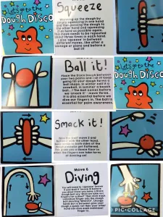

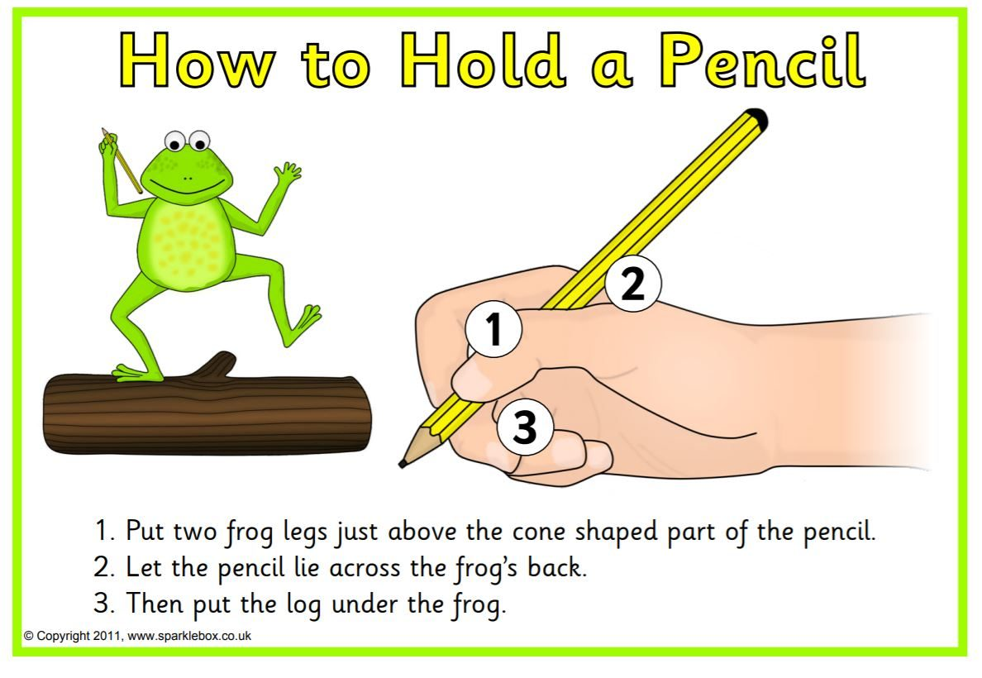
Strengthening finger muscles for writing
Notes:
GS

