Slide 1

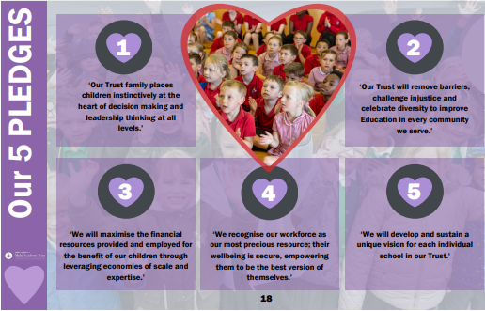
Bath and Wells Multi Academy Trust
All Saints Church School
School Development Plan Priorities 2024-2025
Jesus says, “All things are possible if you believe.” Mark 9:23
All Saints Church School Values
PERSERVERANCE| RESPECT | COMMUNITY| LOVE | FRIENDSHIP | WISDOM
OUR STRATEGIC GOALS
Goal 1:
To ensure that high expectations are consistently expected within all teaching, learning provision and behavioural approaches, across the school
Goal 2:
To participate in the Flourishing People project which will help to drive high expectations and ensure SEN needs are met.
Goal 3:
To develop and enrich the foundation curriculum areas and assessment practices in these areas.
Goal 4:
To review and continue to address the key questions in the SIAMS framework ensuring the school has secured robust qualitative evidence to demonstrate that the school is living up to its foundation as a church school, enabling all to flourish.
We believe that by helping each other, we can grow to be the very best. Our community cares and nurtures all children in a safe learning environment by being open minded to curiosity and creativity. We always show respect, love and perseverance to everyone within our school. LIKE THE GOOD SHEPHERD, if we remember all our school values and our individual gifts from God, we can build upon our wisdom for the greater community. Within a culture of compassion and friendship, we can become the best versions of ourselves!
When we work together, we can make everything possible.
All things will be possible if we believe.
BWMAT 5 PLEDGES
OUR SCHOOL VISION
Our Education Strategy is built on ‘Seven Characteristics of Excellence’. Through co-production with schools, we have identified what we believe will make the biggest difference to children achieving the best. Reflective Leadership; Starting well together on their education journey; A curriculum for an ever-changing world; Teaching excellence along with inspired learning; The celebration of diversity and difference; An environment where physical and mental wellbeing encourages learning to flourish; Outward facing opportunities - looking beyond the horizon;
We know and believe if these key characteristics are at the forefront of everything we do, we will achieve excellence.

