Slide 1
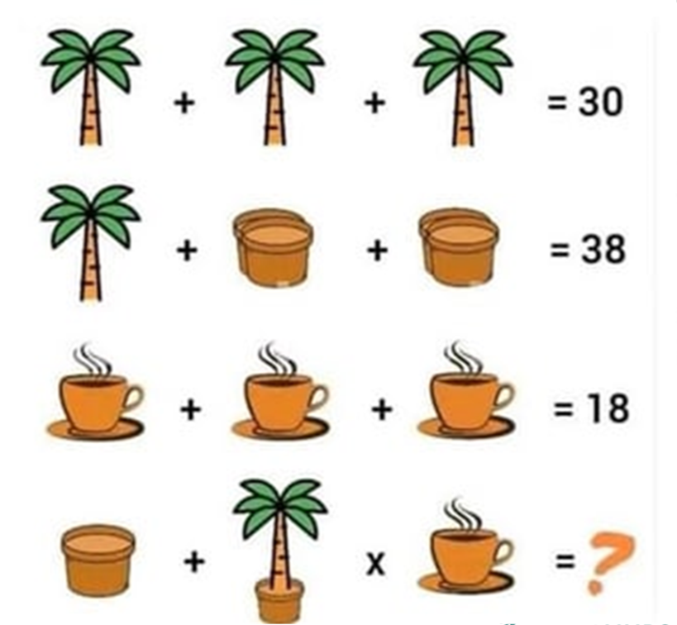
A little bit of maths to get you started!

Slide 2
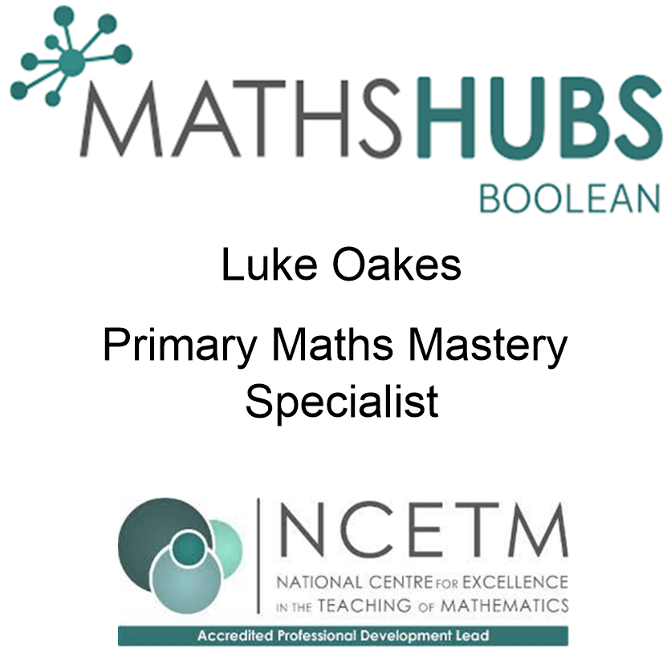

Slide 3
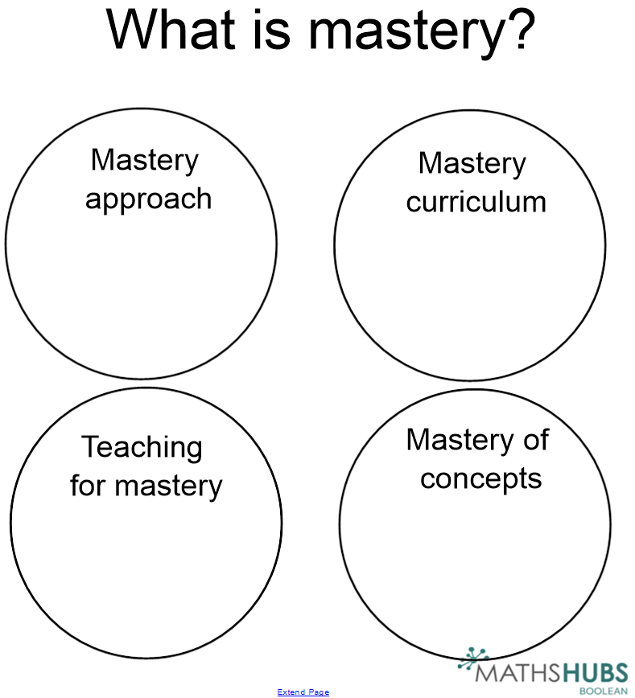

Slide 4
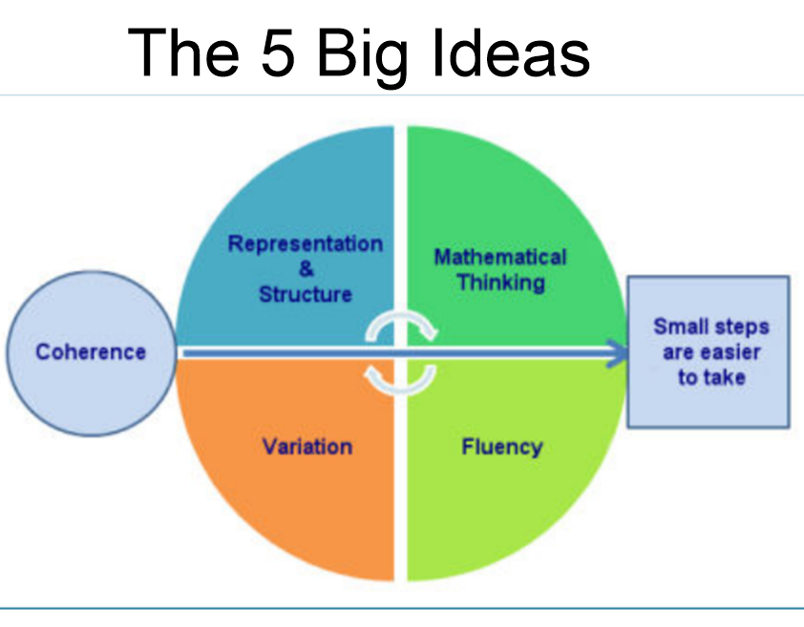

Slide 5
Key Principles
Pupils are taught through whole-class interactive teaching,
The approach endorses a ping-pong approach
Pupils are given opportunities to reason – how do you know? Can you find another way?
If a pupil fails to grasp a concept or procedure, they are quickly identified
Significant time is spent developing deep understanding of the key ideas that are needed to underpin future learning.
Key number facts are learnt to automaticity, learned deeply and practised regularly, to avoid cognitive overload in working memory and enable pupils to focus on new learning.

Slide 6
Why mastery?
- Many schools in England have adopted this way of teaching maths
- Inspired by maths teaching from Japan and Singapore
- Children were leaving primary school and secondary school without the required understanding of maths
- Substantial funding provided by the Dfe - highlights the belief in the approach

Slide 7
Representation and Structure
What is the maths being taught and how can we show this?
How can I get the children to see the maths?
“What is the difference between 12 and 7?”

Slide 8
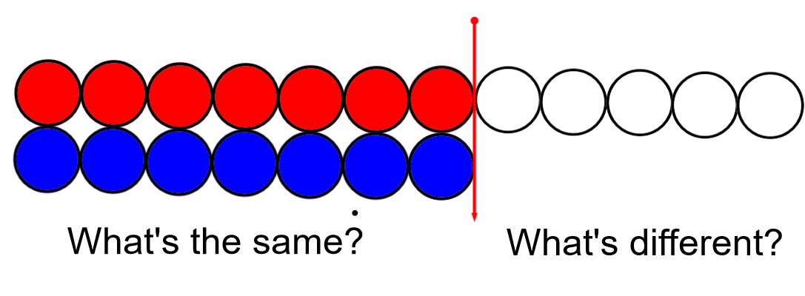
Representation and Structure
What is the maths being taught and how can we show this?
How can I get the children to see the maths?
“What is the difference between 12 and 7?”

Slide 9
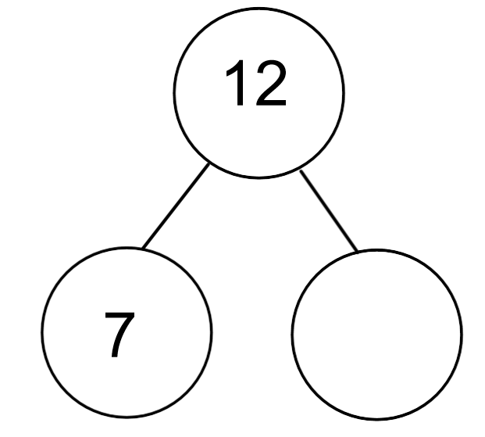
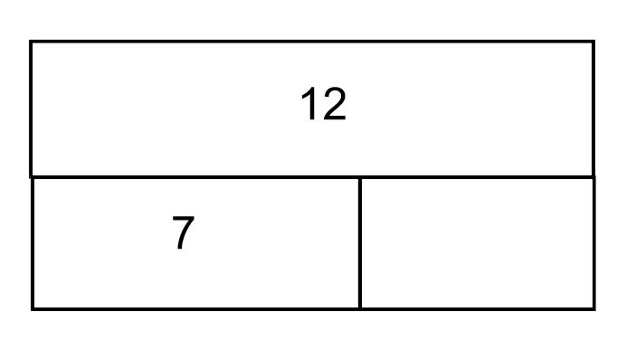
Representation and Structure
What is the maths being taught and how can we show this?
How can I get the children to see the maths?
“What is the difference between 12 and 7?”

Slide 10
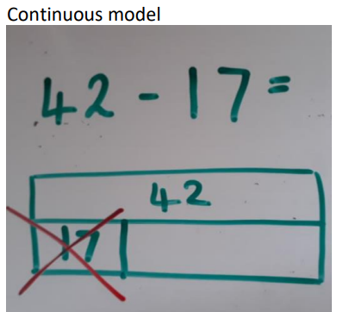
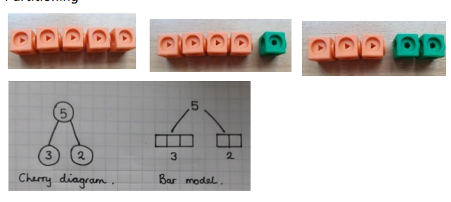
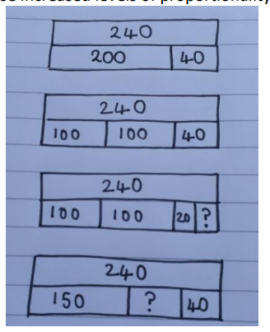
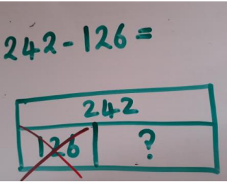
Bar modelling:
Bar modelling is designed to help children represent underlying structures and visualise maths problems.

Slide 11
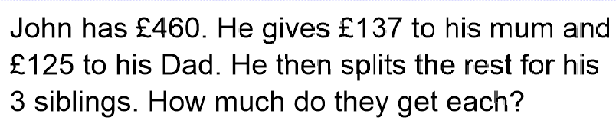
Representation and Structure

Slide 12
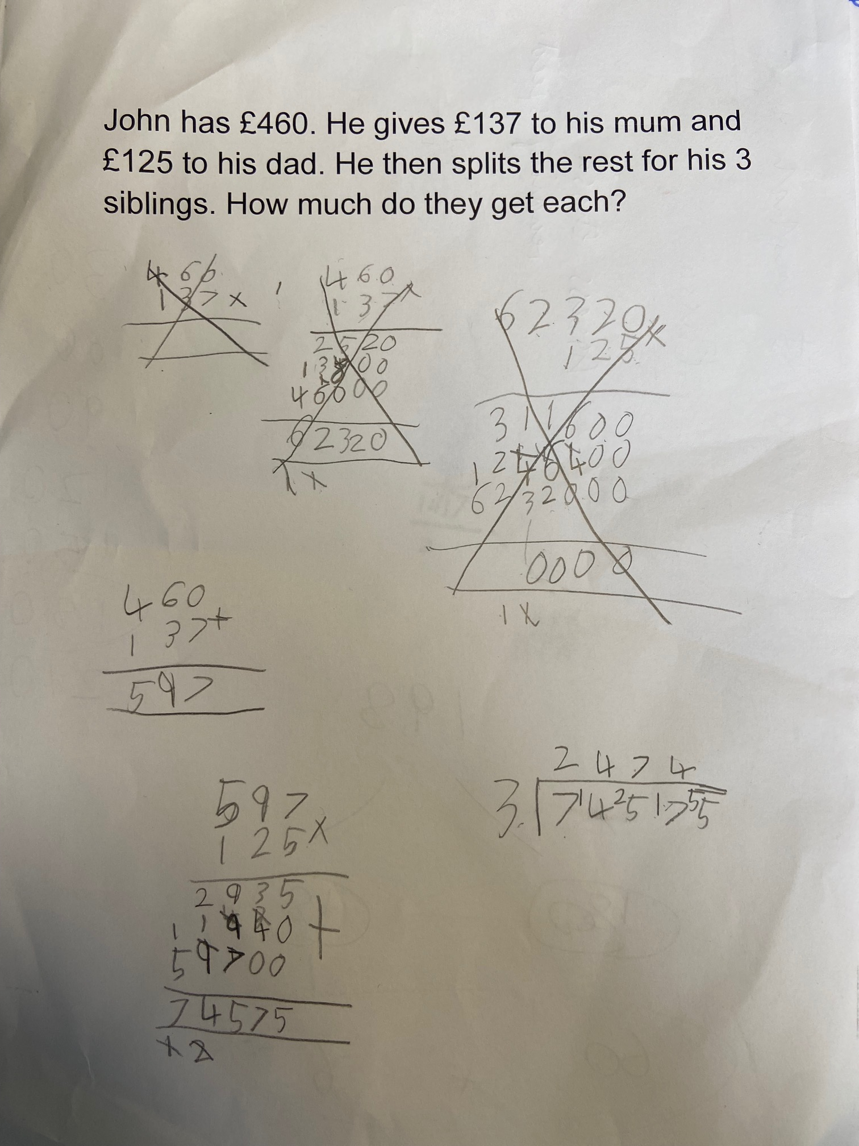
John has £460. He gives £137 to his mum and £125 to his Dad. He then splits the rest for his 3 siblings. How much do they get each?

Slide 13
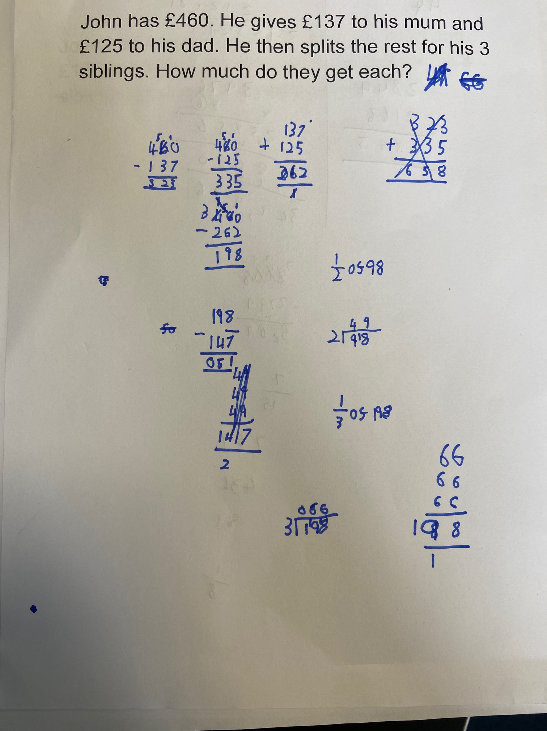
John has £460. He gives £137 to his mum and £125 to his Dad. He then splits the rest for his 3 siblings. How much do they get each?

Slide 14
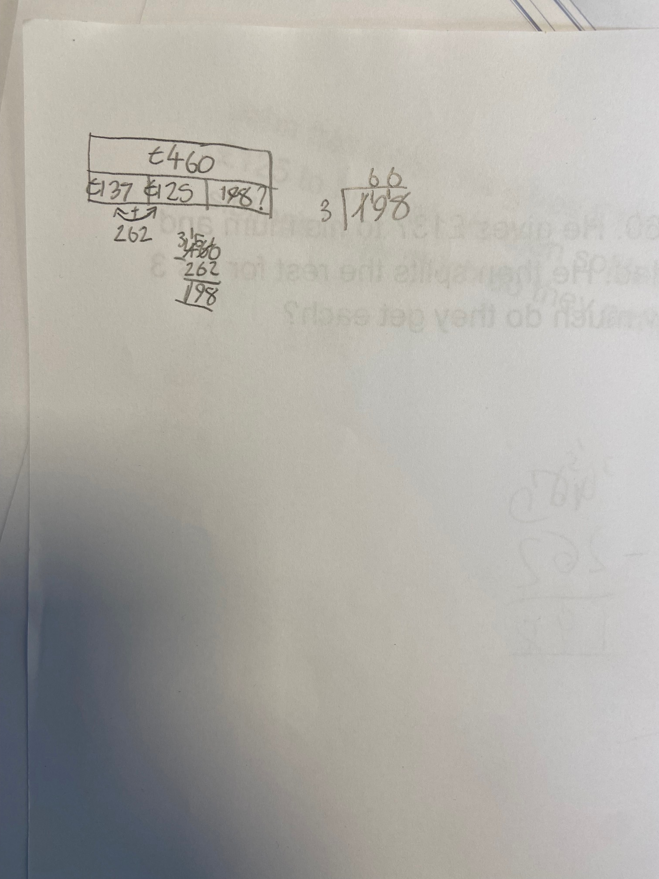
John has £460. He gives £137 to his mum and £125 to his Dad. He then splits the rest for his 3 siblings. How much do they get each?

Slide 15
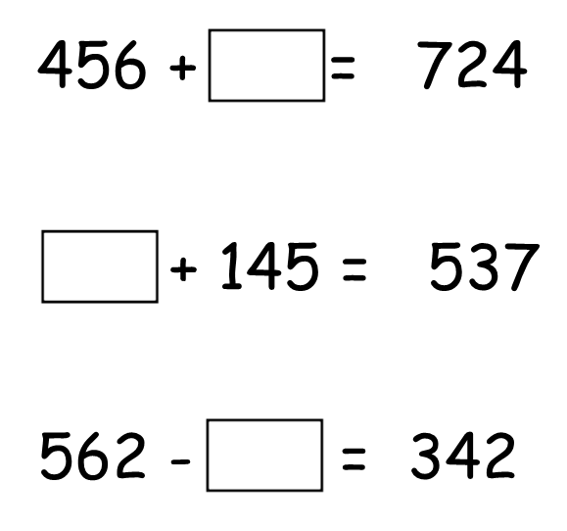

Slide 16
Daniel has 5 times more coins than Sophie. Daniel gives Sophie 26. They now have the same number of coins.
How many coins did they have at the beginning?

Slide 17
Mathematical Thinking
If taught ideas are to be understood deeply, they must not merely be passively received but must be thought about, reasoned with and discussed with others.
Can you show me a different way?
How do you know?
True or False?
Odd one out?

Slide 18
Fluency Key Messages – more than just remembering facts!
1. It encompasses a mixture of efficiency, accuracy and flexibility. (not relying on written methods)
2. Quick and efficient recall of facts and procedures is important in order for students to keep track of sub-problems, think strategically and solve problems.
3. Fluency also demands the flexibility to move between different contexts and representations of mathematics, to recognise relationships and make connections, and to make appropriate choices from a whole toolkit of methods, strategies and approaches.

Slide 19
Mastering Number
This project aims to secure firm foundations in the development of good number sense for all children from Reception through to Year 1 and Year 2. The aim over time is that children will leave KS1 with fluency in calculation and a confidence and flexibility with number. Attention will be given to key knowledge and understanding needed in Reception classes, and progression through KS1 to support success in the future.

Slide 20
Aims & beliefs of the programme
To stop basic number facts being solved through finger counting
To provide children with a range of strategies to calculate
This leads to the automatic recall of number facts to avoid cognitive overload
Avoid the temptation of moving too quickly through the programme
Plentiful consolidation and practice

Slide 21
Mastering Number
SUBITISING!

Slide 22
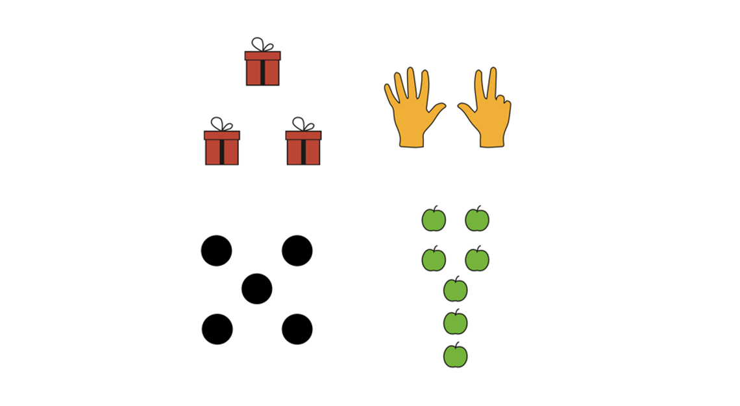
Mastering Number

Slide 23
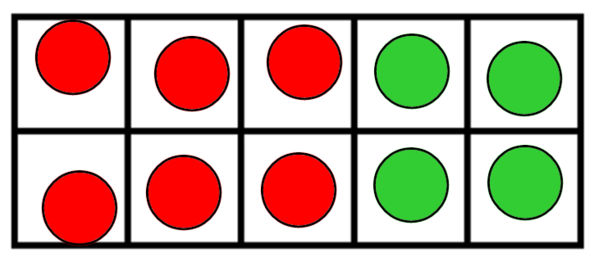
Mastering Number

