Slide 1

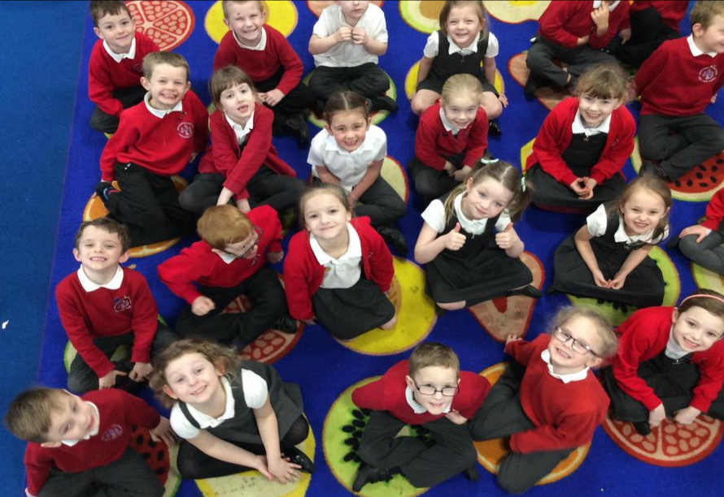
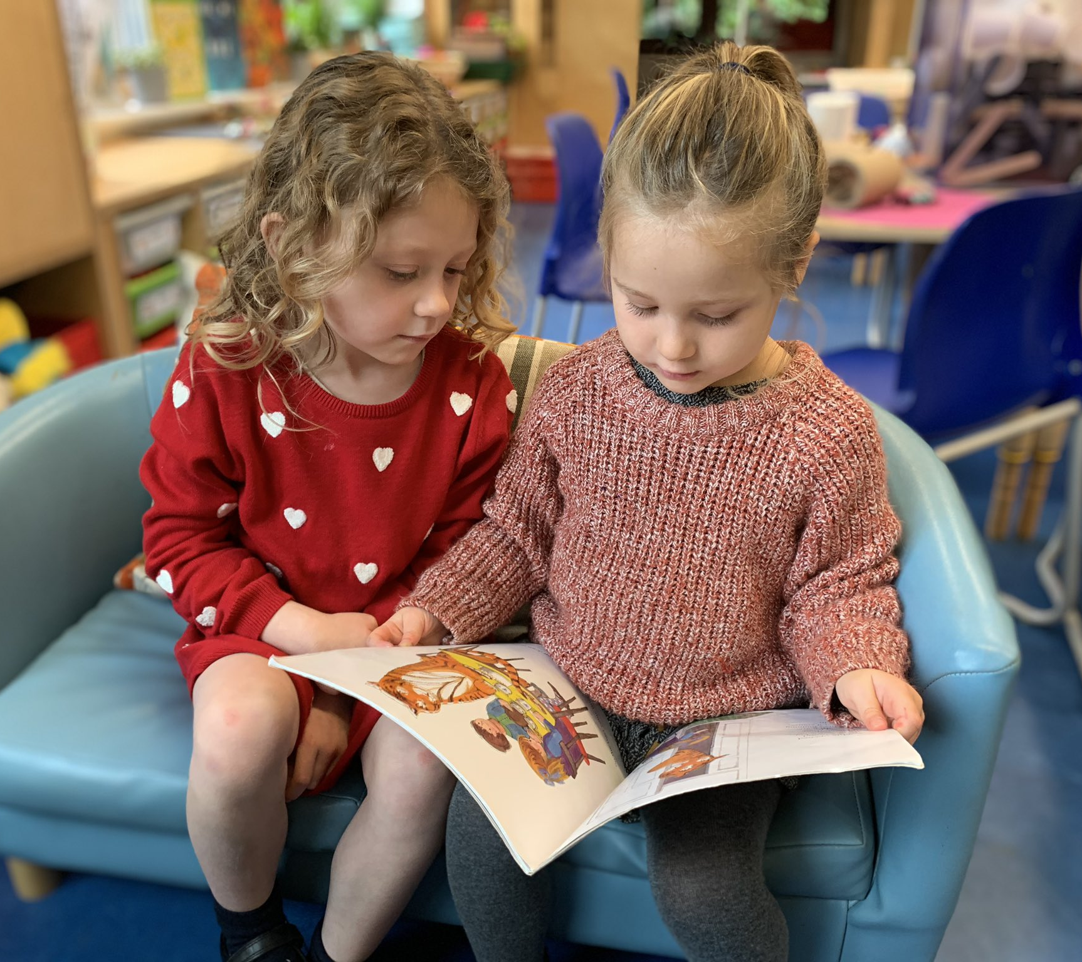
Bath and Wells Multi Academy Trust
All Saints Church School
School Development Plan Priorities 2023-2024
Jesus says, “All things are possible if you believe’. Mark 9:23
All Saints Church School Values
Love, Perseverance, Friendship, Community, Respect, Wisdom
OUR STRATEGIC GOALS
T
Goal 1:
To develop and embed a whole school positive behaviour strategy
Goal 2:
To further develop assessment for all foundation subjects which is SMART, informative and impactful
Goal 3:
To ensure all RE teaching and learning opportunities are good to outstanding
Goal 4:
To embed a systematic and synthetic phonics scheme
All Saints Church School vision
Jesus says, “All things are possible if you believe.”
And we believe that by working together, we can grow the very best, bespoke version of All Saints Church School.
If we can ignite, inspire and nurture curiosity and creativity, self-motivation and self-confidence, then
All things will be possible if we believe…
If we value and nurture the sparkle of all individuals, in a safe learning environment, with equality underpinning all efforts, children will be able to be the best version of themselves, valuing their own self-worth, knowing that
All things will be possible if we believe…
If we create a culture of compassion, trust and shared values, ensuring we all work together – both within the school and as part of the wider community - then
All things will be possible if we believe…
If, by utilising an extraordinary talented team of adults, we can encourage trial and error to help develop resilience and perseverance, our children will become lifelong learners and
All things will be possible if we believe……
If by peeling back the layers of understanding we have a greater wisdom of life; little by little, deeper and deeper and day by day,
As Jesus says, “All things will be possible if we believe,”
And we believe it is!
BWMAT CORE RESPONSIBILITIES
OUR VISION
MORAL & ETHICAL VALUES
Our distinctively Christian ethos underpins all the work of the Trust and every aspect of curriculum delivery.
We reinforce values of kindness, respect, forgiveness, perseverance and love.
Alongside an outstanding education, we deliver a focus on the quality of our children’s characters.
We guarantee year-round support for the most vulnerable and less well-off, as well as those who suffer discrimination and those living with disability.
EDUCATIONAL & ASPIRATIONAL VALUES
Every child will experience the highest quality teaching and learning. This teaching and learning will be delivered in the best possible environment.
Teaching staff are committed to the best and most innovative practice and research.
All children from all backgrounds are given the chance to change their lives positively through learning.
Every school is on a trajectory to become or
remain outstanding.
Outstanding leaders in all our schools.

